Slide 1
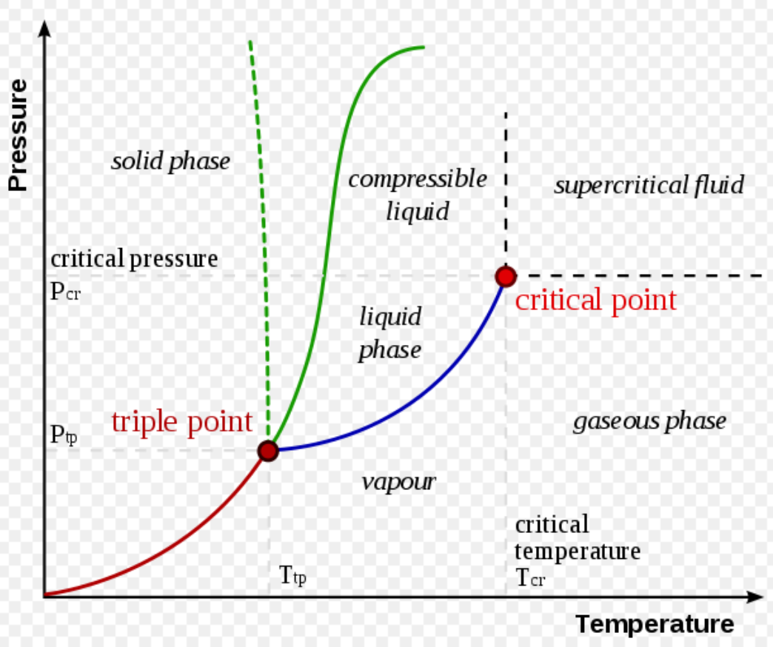
Chemical Engineering Thermodynamics Lecture 2 The PVT Behavior Xiaofei Xu

Slide 2

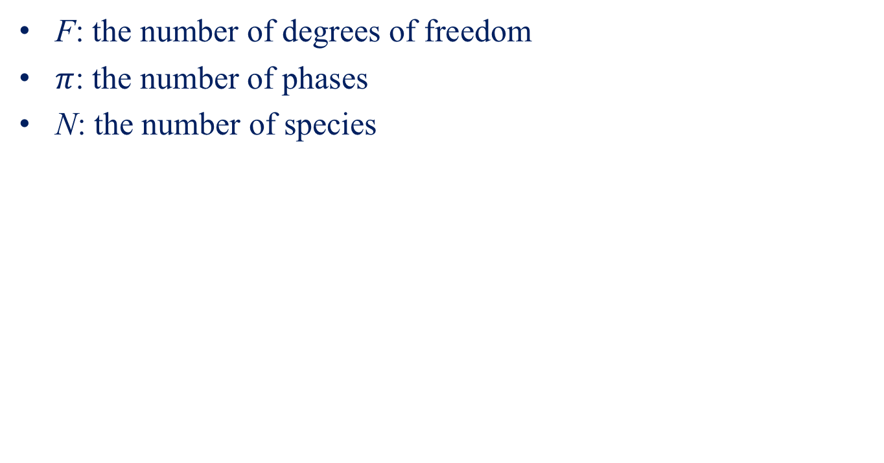
The Phase Rule
$$F=2−π+N$$
F: the number of degrees of freedom
$π$: the number of phases
N: the number of species

Slide 3
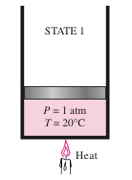
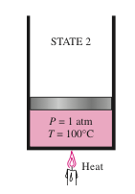
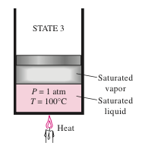
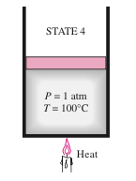
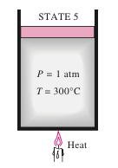
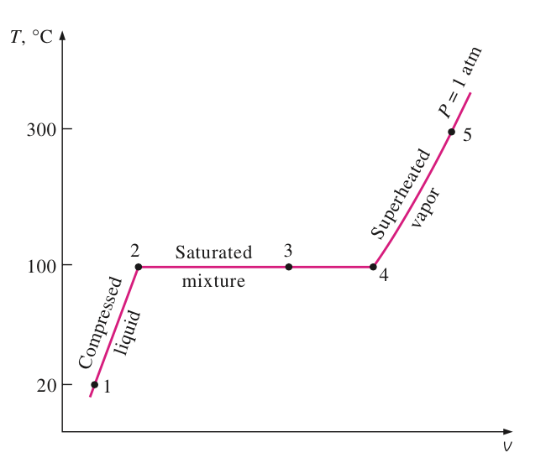
Liquid-Vapor Phase Transition

Slide 4
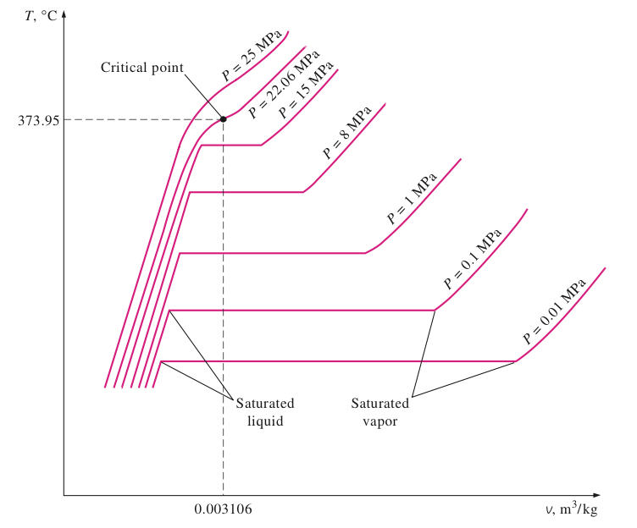
T-V Phase Diagram

Slide 5
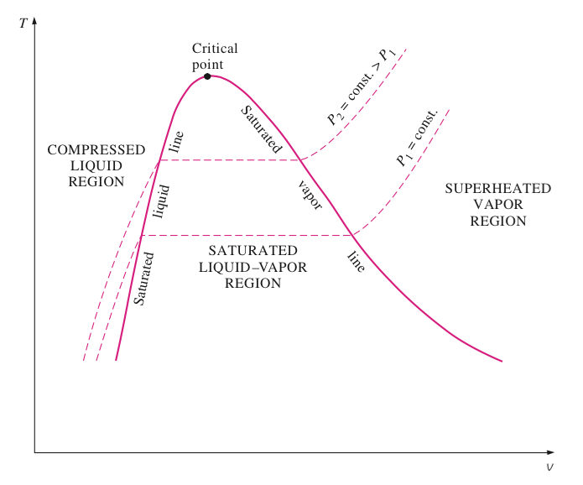
T-V Phase Diagram

Slide 6
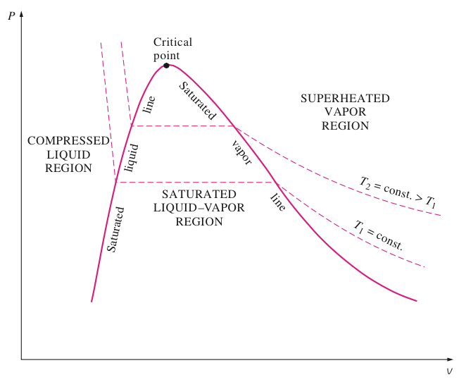
P-V Phase Diagram

Slide 7
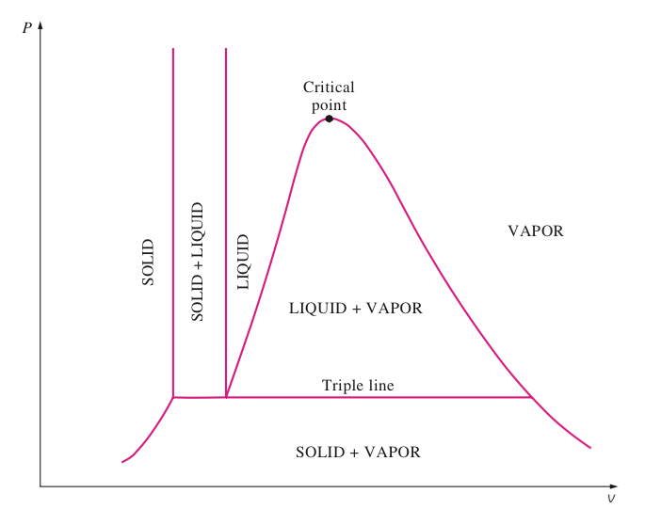
Full Phase Diagram

Slide 8
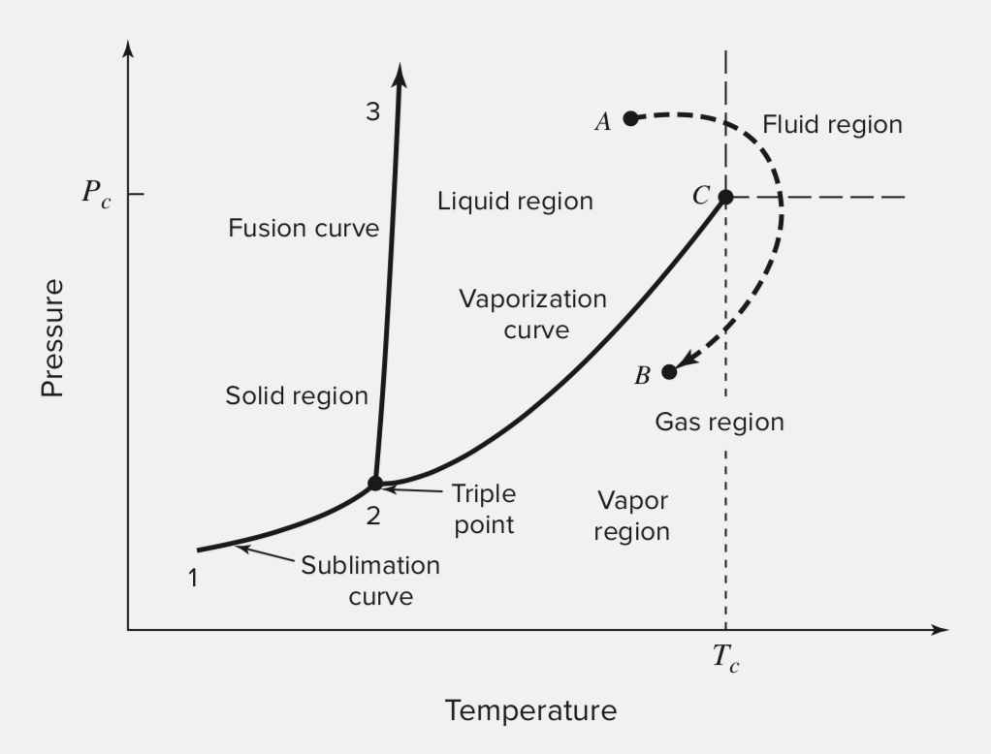
PT Phase Diagram

Slide 9
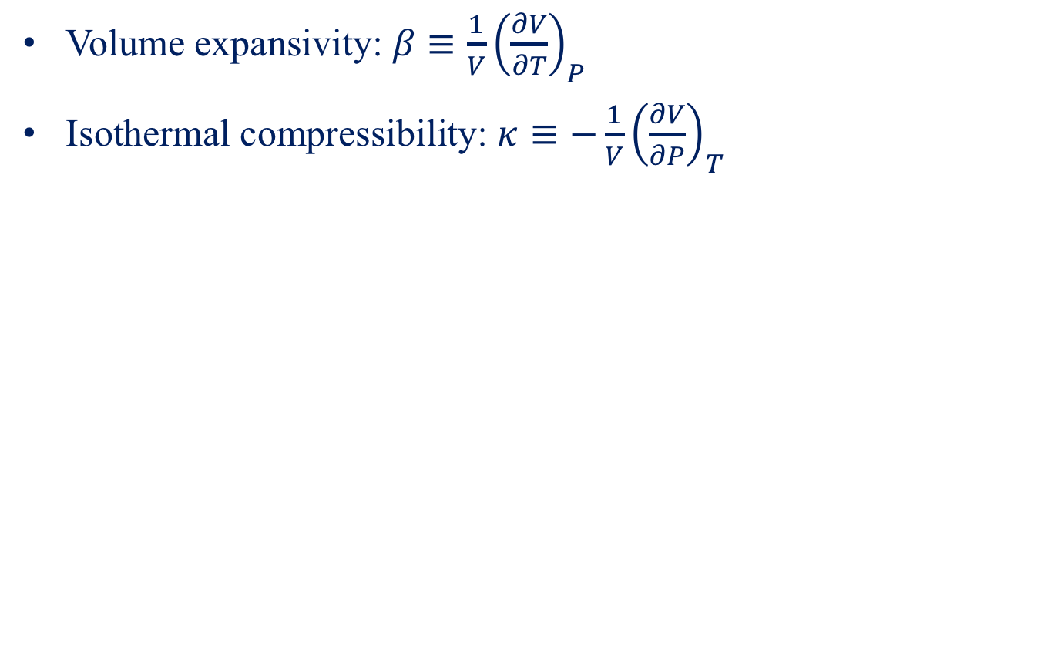
Compressibility
Volume expansivity: $β≡\frac{1}{V}{\left(\frac{∂V}{∂T}\right)}_{P}$
Isothermal compressibility: $κ≡−\frac{1}{V}{\left(\frac{∂V}{∂P}\right)}_{T}$

Slide 10
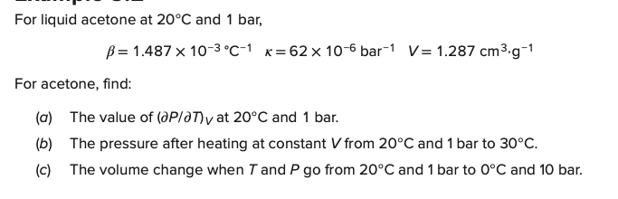
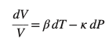
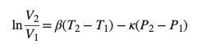
Example

Slide 11
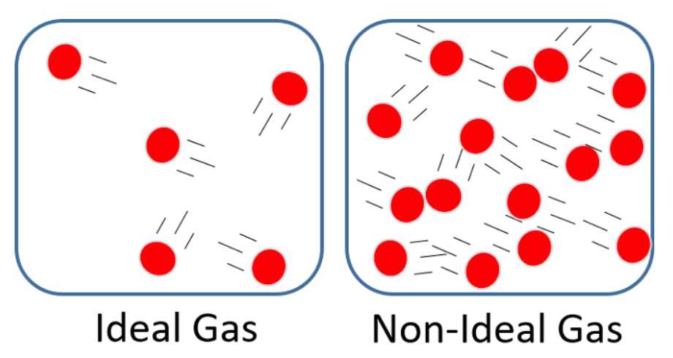
Ideal Gas
Point particles with no volume
No interaction; move randomly and independently
Collide elastically by following Newton’s 2nd law
Real gas at high T or low P can be regarded as ideal gas

Slide 12
Ideal-Gas EOS
Boltzmann constant

Slide 13
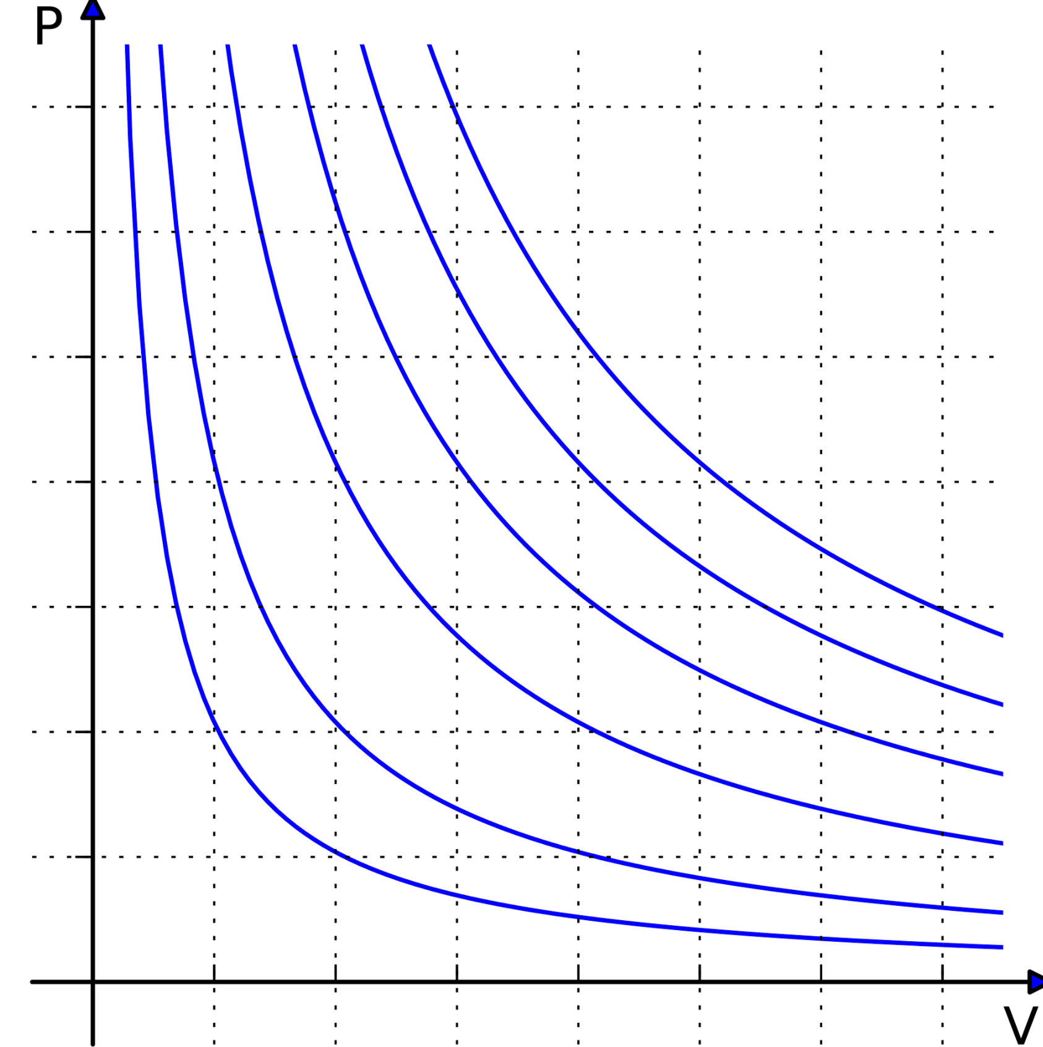
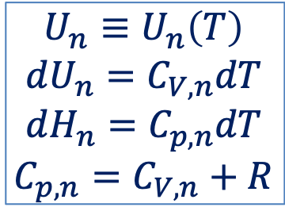
Internal Energy and Enthalpy
Joule’s second law
The internal energy of ideal gas depends only on it temperature
Isotherms
$$U_{n}≡U_{n}\left(T\right)$$
$$dU_{n}=C_{V,n}dT$$
$$dH_{n}=C_{p,n}dT$$
$$C_{p,n}=C_{V,n}+R$$

Slide 14
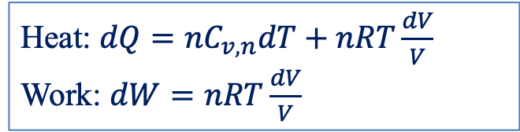
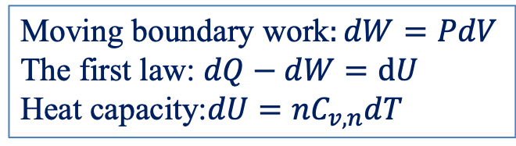
Heat Transfer and Work
Moving boundary work$:dW=PdV$
The first law: $dQ−dW=dU$
Heat capacity:$dU={nC}_{v,n}dT$
Heat: $dQ={nC}_{v,n}dT+nRT\frac{dV}{V}$
Work: $dW=nRT\frac{dV}{V}$

Slide 15
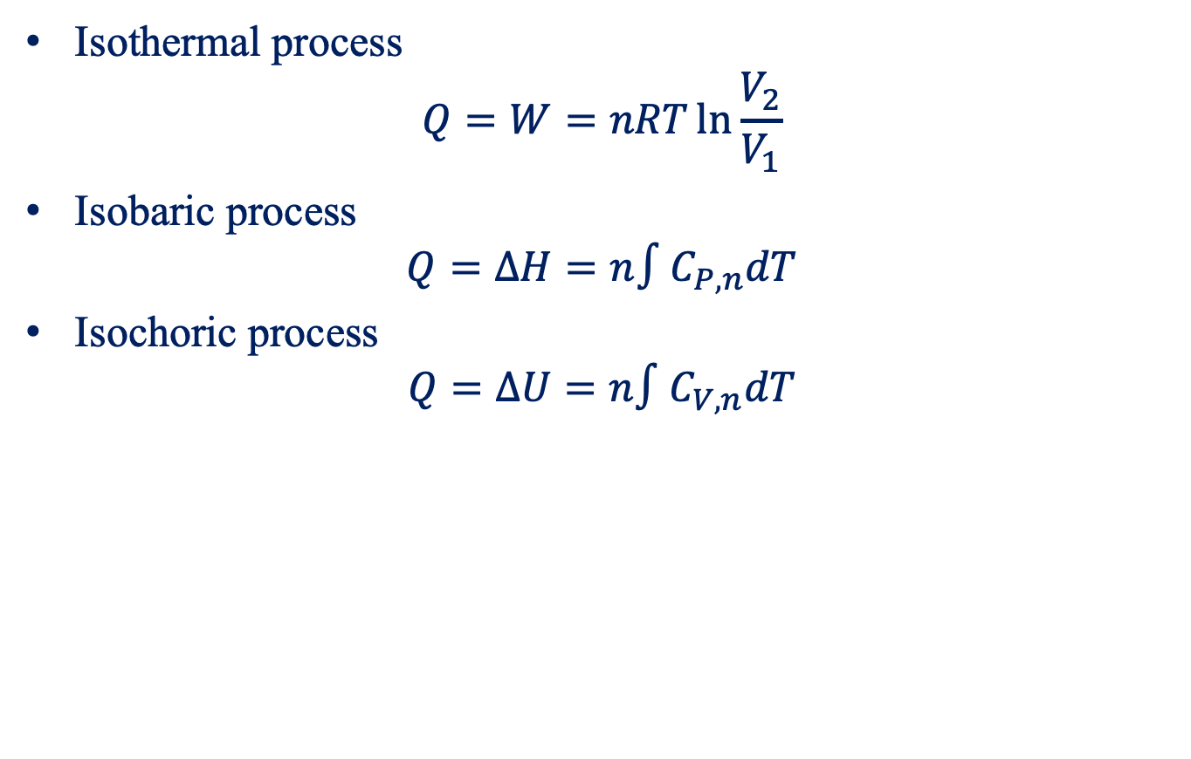
Ideal-Gas Process
Isothermal process
$$Q=W=nRT\ln{\frac{V_{2}}{V_{1}}}$$
Isobaric process
$$Q=ΔH=n∫C_{P,n}dT$$
Isochoric process
$$Q=ΔU=n∫C_{V,n}dT$$

Slide 16
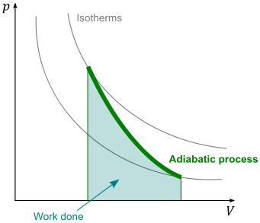
Adiabatic Process and Poisson Equation

Slide 17
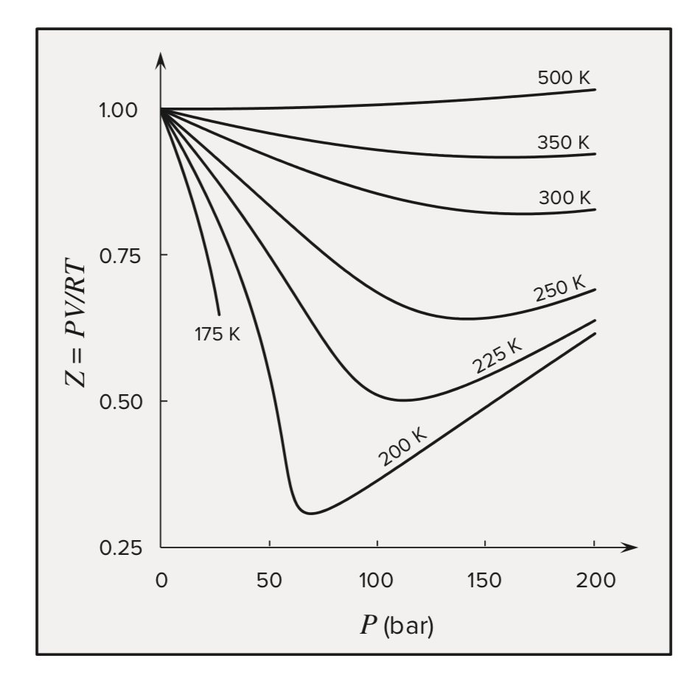
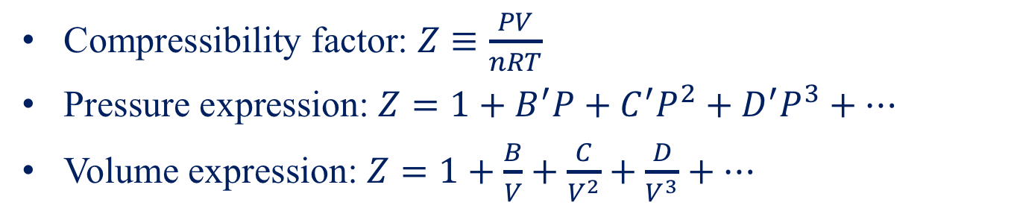
Virial EOS
Compressibility factor: $Z≡\frac{PV}{nRT}$
Pressure expression: $Z=1+B^{′}P+C^{′}P^{2}+D^{′}P^{3}+…$
Volume expression: $Z=1+\frac{B}{V}+\frac{C}{V^{2}}+\frac{D}{V^{3}}+…$
Compressibility factor graph for methane

Slide 18
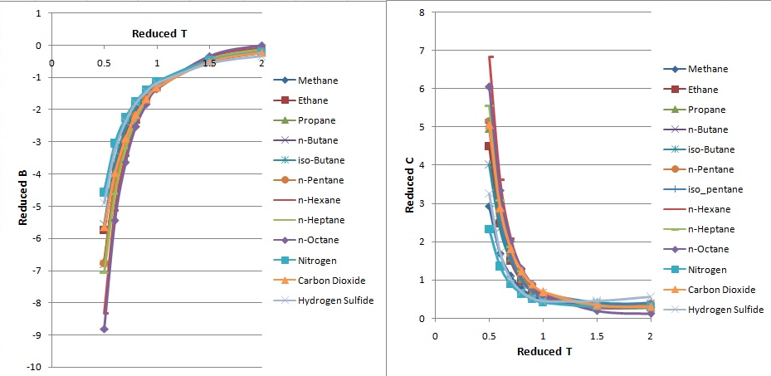
Virial EOS

Slide 19
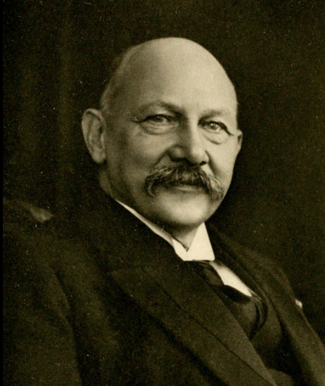
Virial EOS
Heike K. Onnes
(1853-1926)

Slide 20
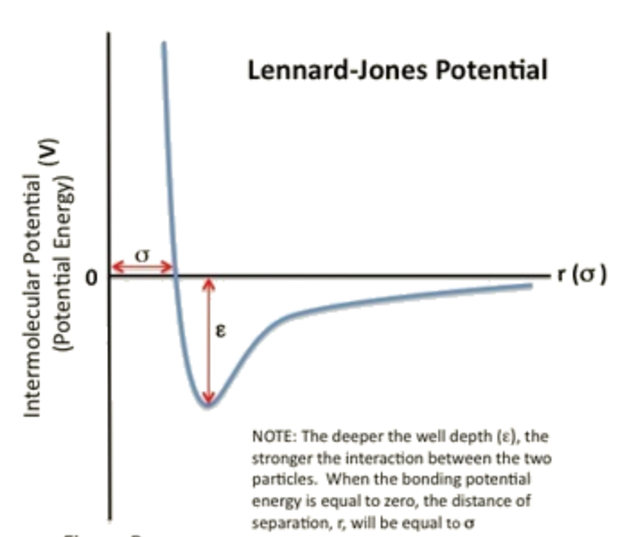
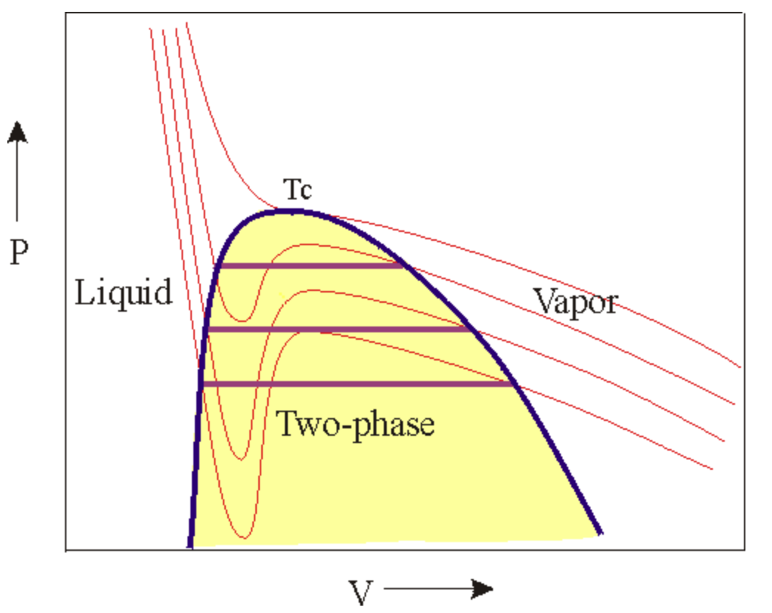
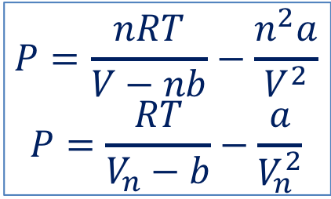
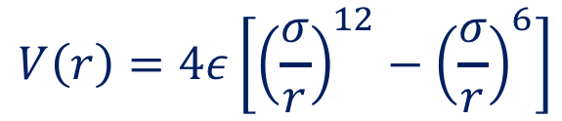
van der Waals EOS
$$P=\frac{nRT}{V−nb}−\frac{n^{2}a}{V^{2}}$$
$$P=\frac{RT}{V_{n}−b}−\frac{a}{V_{n}^{2}}$$
a: attractive force between molecules
b: molecular volume
Isotherms
$$V\left(r\right)=4ε\left[{\left(\frac{σ}{r}\right)}^{12}−{\left(\frac{σ}{r}\right)}^{6}\right]$$

Slide 21
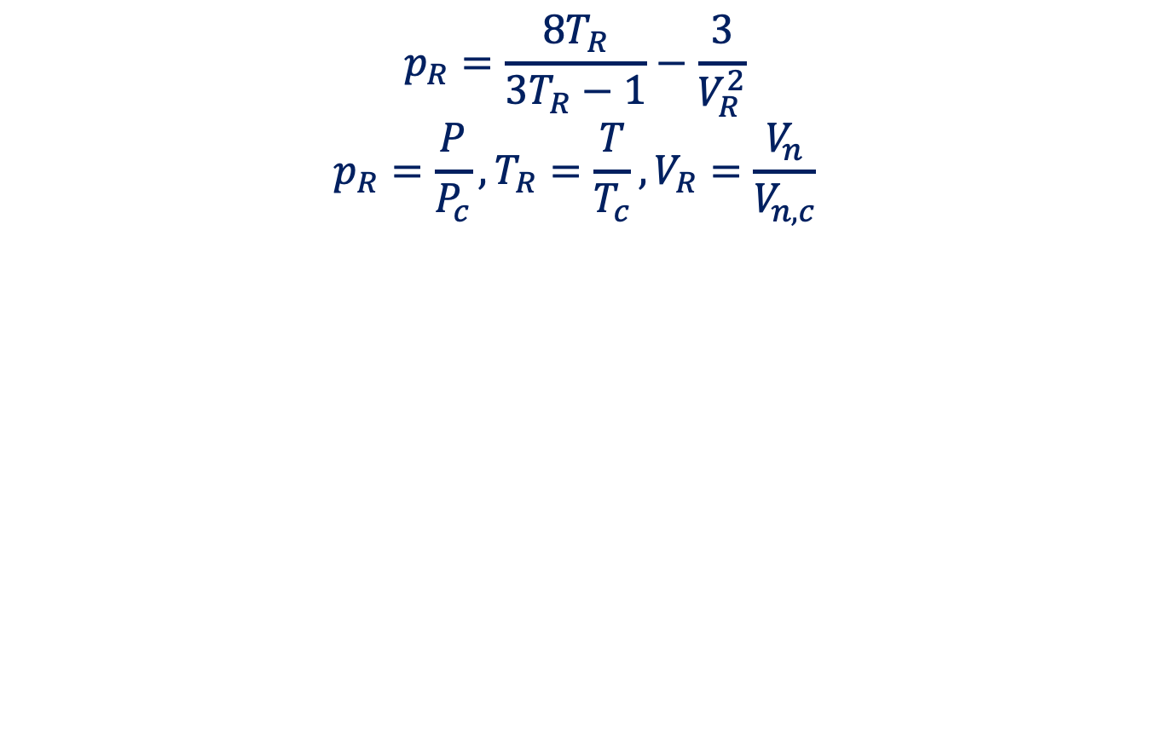
Reduced van der Waals EOS
$$p_{R}=\frac{8T_{R}}{3T_{R}−1}−\frac{3}{V_{R}^{2}}$$
$$p_{R}=\frac{P}{P_{c}},T_{R}=\frac{T}{T_{c}}, V_{R}=\frac{V_{n}}{V_{n,c}}$$

Slide 22
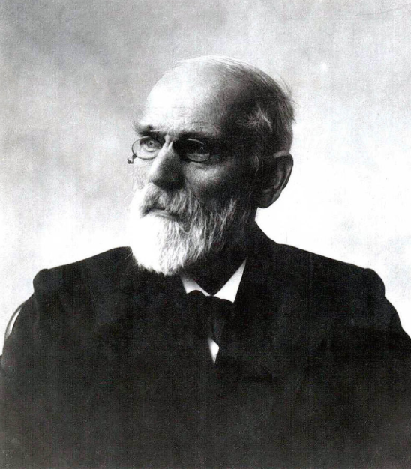
van der Waals
Johannes van der Waals
1837-1923

Slide 23
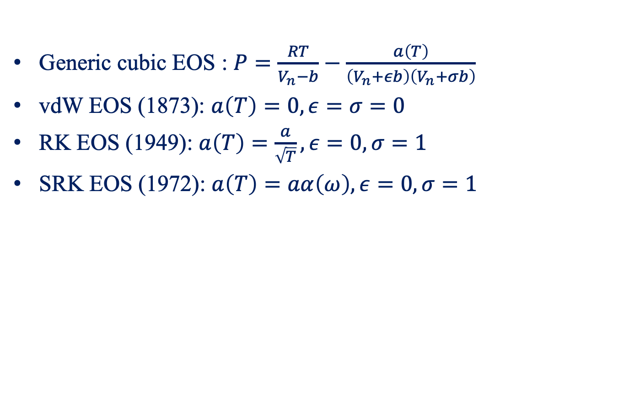
Cubic EOS
Generic cubic EOS : $P=\frac{RT}{V_{n}−b}−\frac{a\left(T\right)}{\left(V_{n}+εb\right)\left(V_{n}+σb\right)}$
vdW EOS (1873): $a\left(T\right)=0,ε=σ=0$
RK EOS (1949): $a\left(T\right)=\frac{a}{\sqrt{T}},ε=0,σ=1$
SRK EOS (1972): $a\left(T\right)=aα\left(ω\right),ε=0,σ=1$

Slide 24
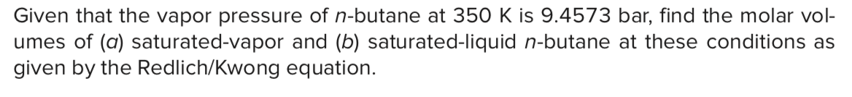
Example

Slide 25
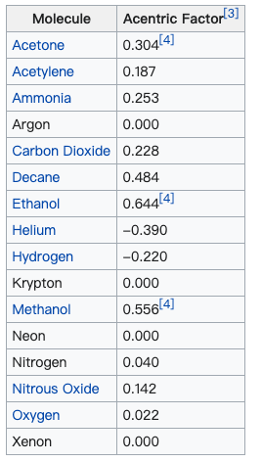
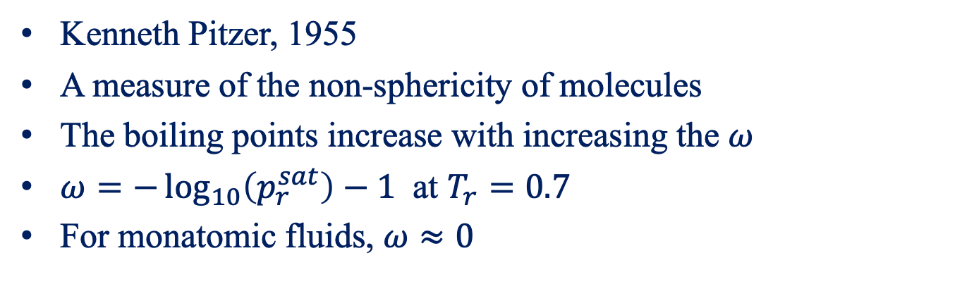

Acentric Factor $ω$
Kenneth Pitzer, 1955
A measure of the non-sphericity of molecules
The boiling points increase with increasing the $ω$
$ω=−\log_{10}\left(p_{r}^{sat}\right)−1$ at $T_{r}=0.7$
For monatomic fluids, $ω≈0$

Slide 26
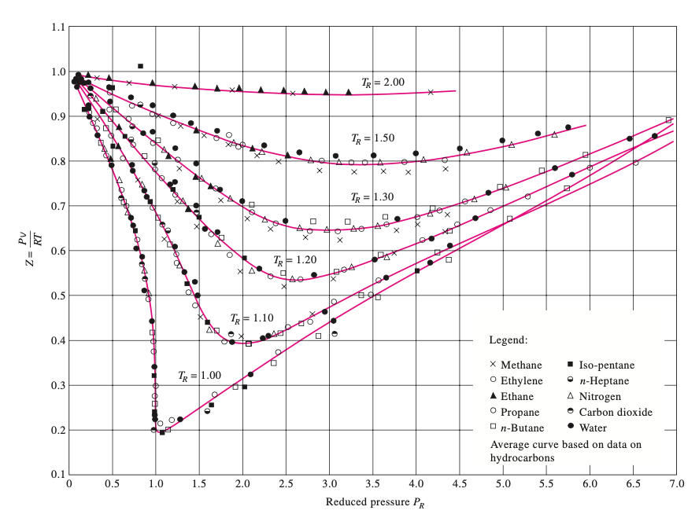
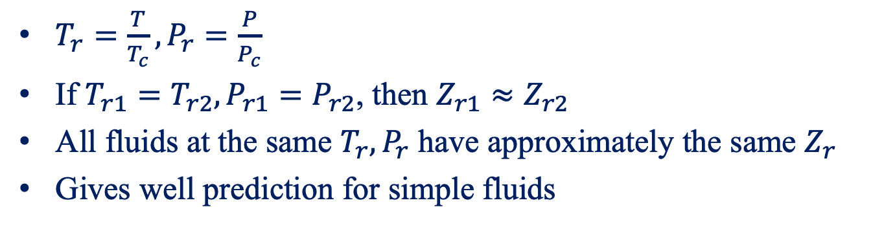
Two-parameters Theorem of Corresponding States
$T_{r}=\frac{T}{T_{c}}, P_{r}=\frac{P}{P_{c}}$
If $T_{r1}=T_{r2}, P_{r1}=P_{r2}$, then $Z_{r1}≈Z_{r2}$
All fluids at the same $T_{r},P_{r}$ have approximately the same $Z_{r}$
Gives well prediction for simple fluids

Slide 27
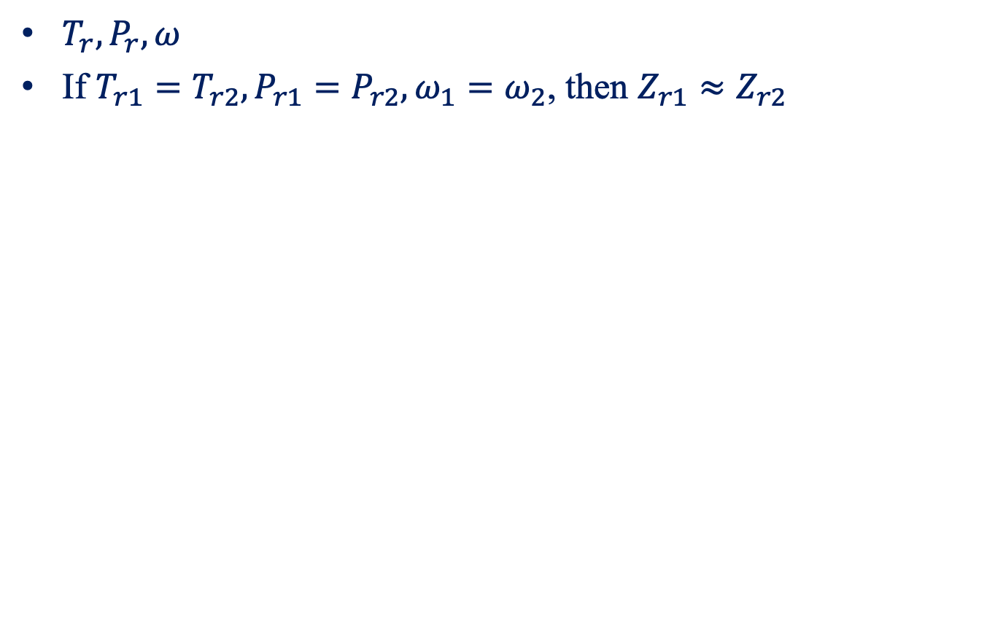
Three-parameter Theorem of Corresponding States
$T_{r}, P_{r},ω$
If $T_{r1}=T_{r2}, P_{r1}=P_{r2}, ω_{1}=ω_{2}$, then $Z_{r1}≈Z_{r2}$

Slide 28
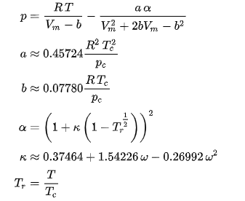
Peng-Robinson EOS (1976)

Slide 29
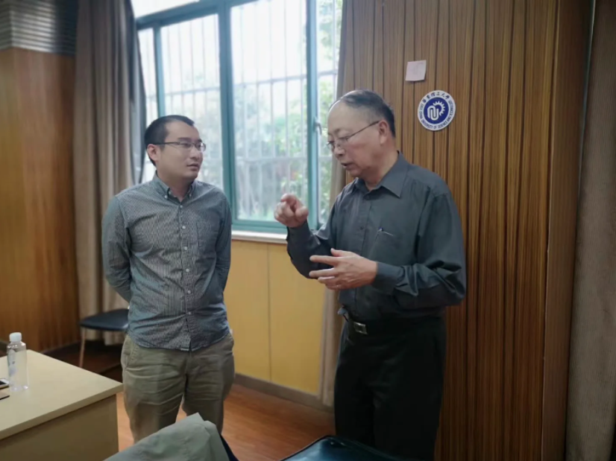
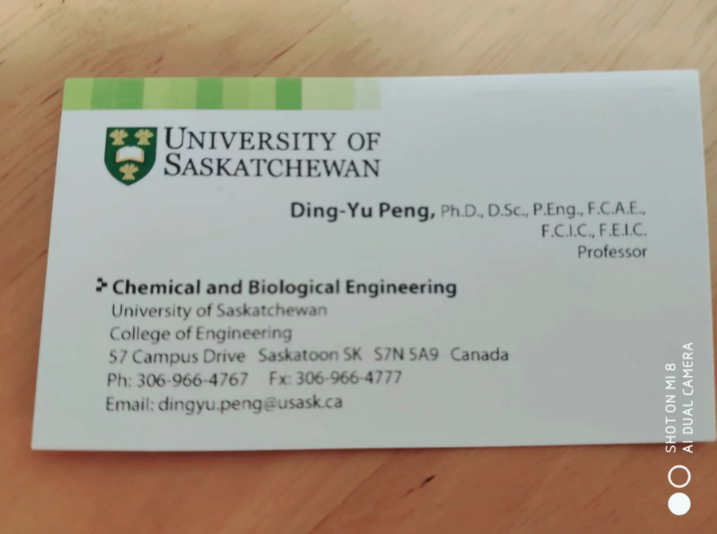
Peng DingYu

Slide 30
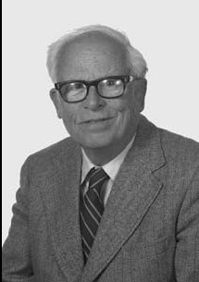
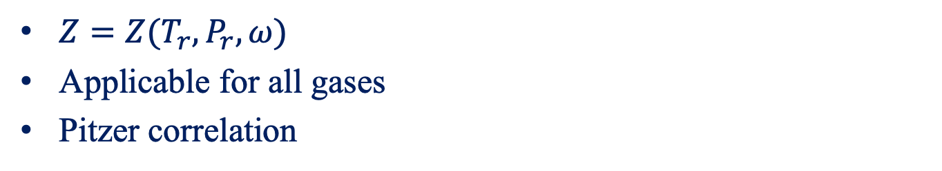
Generalized Correlations for Gases
$Z=Z(T_{r},P_{r},ω)$
Applicable for all gases
Pitzer correlation
Kenneth Pitzer
(1914-1997)

Slide 31
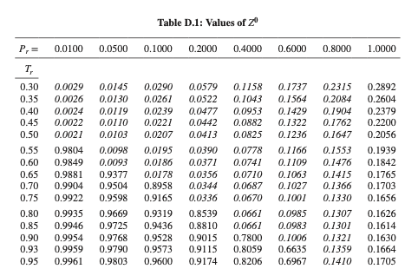
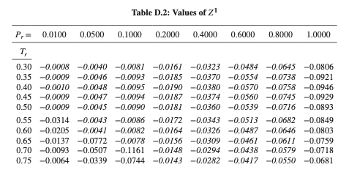
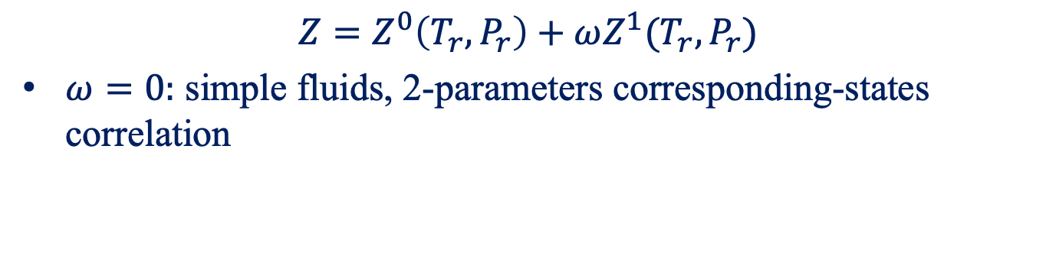
Pitzer Correlations for Z
$$Z=Z^{0}\left(T_{r},P_{r}\right)+ωZ^{1}(T_{r},P_{r})$$
$ω=0:$ simple fluids, 2-parameters corresponding-states correlation

Slide 32
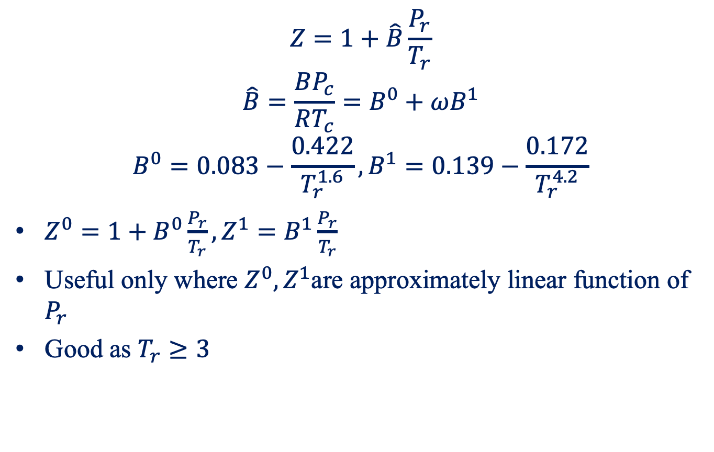
Pitzer Correlations for B
$$Z=1+\hat{B}\frac{P_{r}}{T_{r}}$$
$$\hat{B}=\frac{BP_{c}}{RT_{c}}=B^{0}+ωB^{1}$$
$$B^{0}=0.083−\frac{0.422}{T_{r}^{1.6}}, B^{1}=0.139−\frac{0.172}{T_{r}^{4.2}}$$
$Z^{0}=1+B^{0}\frac{P_{r}}{T_{r}}, Z^{1}=B^{1}\frac{P_{r}}{T_{r}}$
Useful only where $Z^{0}, Z^{1}$are approximately linear function of $P_{r}$
Good as $T_{r}≥3$

Slide 33

Example

Slide 34


Evaluation of $Z^{0}$

Slide 35


Evaluation of $ω$

Slide 36
Summary Points
The phase rule
PVT behavior and phase diagram
Ideal gas
Ideal gas EOS
van der Waals EOS
Virial EOS
Generalized correlations for gases

